Slide 1
Project 1: Interpretable and Explainable Classification for Medical Data
Alain Ryser, Moritz Vandenhirtz
07.03.2023

Slide 2

Big challenge to incorporate AI in clinical practice
Most practitioners do not trust AI-based clinical tools (1)
Interpretability and Explainability of models can build transparency and trust (2)
(1) https://www.fda.gov/media/143310/download
(2) He, J., Baxter, S.L., Xu, J. et al. The practical implementation of artificial intelligence technologies in medicine. Nat Med 25, 30–36 (2019)

Slide 3
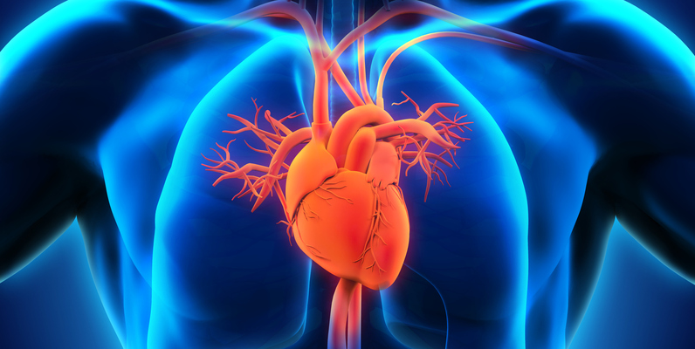
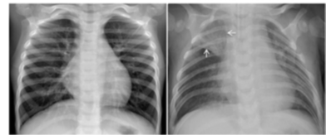
Project 1: Interpretability and Explainability
Part 1: Tabular data for predicting coronary heart disease
Part 2: X-ray data for predicting pneumonia

Slide 4
Organisational
Submit the report and code on Moodle until 18.04.2023.
Report must be a PDF and code should follow the guidelines on the handout.
Do not train on the test sets and only provide results that are evaluated on the test set.
If you encounter computational difficulties due to hardware constraints, feel free to subsample or preprocess/resize the data to reduce dimensionality. Please clearly state if you apply such preprocessing, it will not impact the grading.
Both datasets are publicly available on Kaggle. It is allowed to use publicly available code (apart from other groups’ work) but make sure to properly reference external sources.
There will be a challenge task for each dataset of which you have to solve at least one to achieve the maximum grade
The best team will be inquired to present their project for a non-cumulative bonus of 0.25 to the final grade.

Slide 5
General Remarks
Please sign up your group on Moodle until 20.03.2023.
Those that don’t have a group yet can meet here after the lecture.
As defined in the lecture, we will talk about ”Interpretability” in the context of intrinsically interpretable models, while we talk about “Explainability” in the context of a black-box model that requires an auxiliary method to explain its predictions.
Interpretability and Explainability are not an exact science. There does not necessarily have to be a single correct answer.
A partial goal of this project is that you use the materials available to you to teach yourself the methods that are being used.
Notes:
Interpretability when explanation is part of the model’s prediction.

Slide 6
Motivation for predicting heart disease
Cardiovascular diseases (CVDs) are by far the number 1 cause of death globally. (1)
CVD is an umbrella term for a number of heart-related conditions.
Of those, coronary heart disease is the most common, being responsible for 16% of the world’s total deaths. (2)
In this project, you will train ML models for early detection of potential coronary heart diseases.
With the help of interpretability and explainability, you will gain insights into which features are important indicators.
These insights can be helpful for understanding the disease as well as build trust of doctors toward a (semi-)automated detection of heart diseases.
(1) IHME, Global Burden of Disease (2019)
(2) https://www.who.int/news-room/fact-sheets/detail/the-top-10-causes-of-death

Slide 7
Clinical Background (1,2,3)
Coronary Heart Disease occurs when plaque builds up in the walls of the arteries.
This narrows the arteries, leading to less oxygen-rich blood getting to your heart.
Possible consequences:
Chest pain (=angina)
Heart failure
Blood clots that block blood flow
→ Heart muscles supplied by that artery begin to die
→ Heart attack
(1) https://www.nhlbi.nih.gov/sites/default/files/media/docs/Fact_Sheet_Know_Diff_Design.508_pdf.pdf
(2) https://www.mayoclinic.org/diseases-conditions/heart-failure/symptoms-causes/syc-20373142
(3) https://www.heart.org/en/health-topics/consumer-healthcare/what-is-cardiovascular-disease
Notes:
Heart failure does not mean that the heart stops beating — that’s a common misperception. Instead, the heart keeps working, but the body’s need for blood and oxygen isn’t being met.

Slide 8
Coronary Heart Disease Prediction Dataset (1,2)
Aggregated dataset from
Hungarian Institute of Cardiology. Budapest: Andras Janosi, M.D.
University Hospital, Zurich, Switzerland: William Steinbrunn, M.D.
University Hospital, Basel, Switzerland: Matthias Pfisterer, M.D.
V.A. Medical Center, Long Beach and Cleveland Clinic Foundation: Robert Detrano, M.D., Ph.D.
918 Observations, 11 Features, 1 Binary response: Blood vessel diameter narrowing < or > 50%.
Train/val - test split provided on Moodle. Please use this split for comparability and reproducibility.
Overall goal: Develop an automated ML model for the early detection of coronary heart disease and leverage interpretability or explainability to rationalize its predictions.
http://archive.ics.uci.edu/ml/datasets/Heart+Disease
https://www.kaggle.com/datasets/fedesoriano/heart-failure-prediction

Slide 9
Tasks for Part 1 (detailed description of deliverables in handout)
Task 1: Exploratory Data Analysis
Before training any classifier, analyse the dataset at hand in order to get an understanding of the data.
Based on this, preprocess the data as you see fit.
As first simple step to understand the relationship between response and features, compute the pairwise correlation matrix.

Slide 10
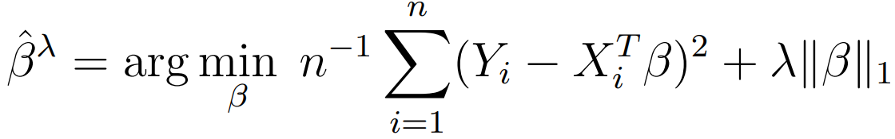
Tasks for Part 1 (detailed description of deliverables in handout)
Task 1: Exploratory Data Analysis
Task 2: Logistic Lasso Regression
Lasso combines the logistic regression with a shrinkage factor, which sets unimportant coefficients to 0.
This provides interpretability by differentiating between important and unimportant features.

Slide 11
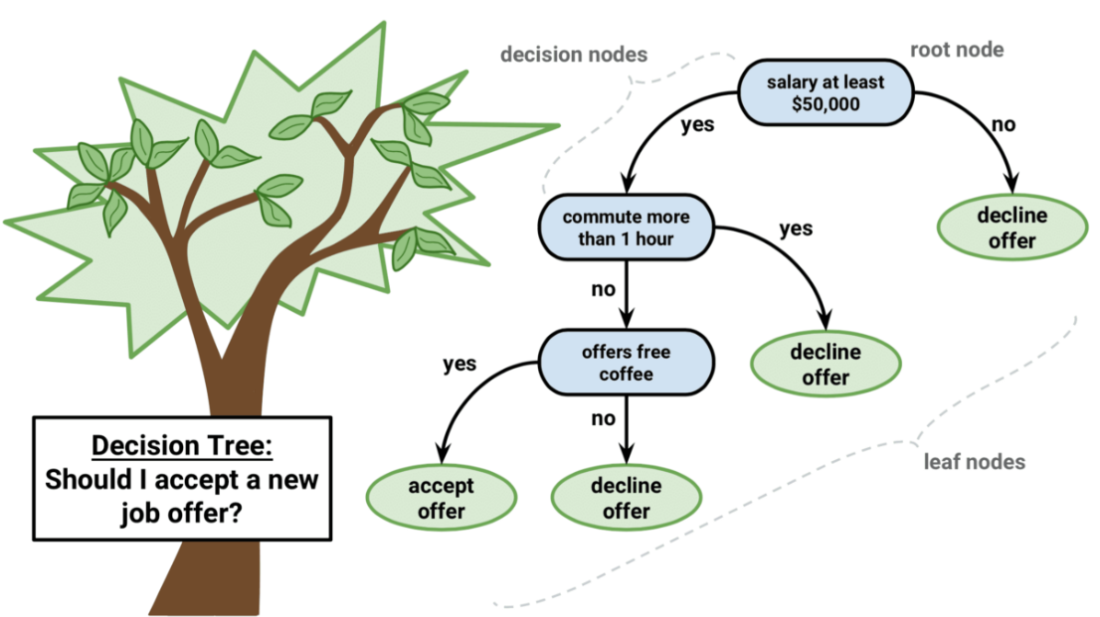
Tasks for Part 1 (detailed description of deliverables in handout)
Task 1: Exploratory Data Analysis
Task 2: Logistic Lasso Regression
Task 3: Decision Trees
(Inherently) interpretable
Feature importance by weighted reduction in impurity (1,2,3)
(1) https://towardsdatascience.com/feature-importance-in-decision-trees-e9450120b445
(2) https://towardsdatascience.com/the-mathematics-of-decision-trees-random-forest-and-feature-importance-in-scikit-learn
(3) https://stackoverflow.com/questions/49170296/scikit-learn-feature-importance-calculation-in-decision-trees/57288460#57288460
Notes:
Feature importance: For each node it is calculated (weightedly) how much the split reduces the impurity of classes. Then nodes containing to the same feature are summed up.

Slide 12
Tasks for Part 1 (detailed description of deliverables in handout)
Task 1: Exploratory Data Analysis
Task 2: Logistic Lasso Regression
Task 3: Decision Trees
Task 4: Multi-layer Perceptrons + SHAP (1)
MLP’s considered as black-boxes.
SHAP is a post-hoc explanation method that computes how much each feature contributes to the final prediction for any given ML model.
(1) https://papers.nips.cc/paper/2017/file/8a20a8621978632d76c43dfd28b67767-Paper.pdf

Slide 13
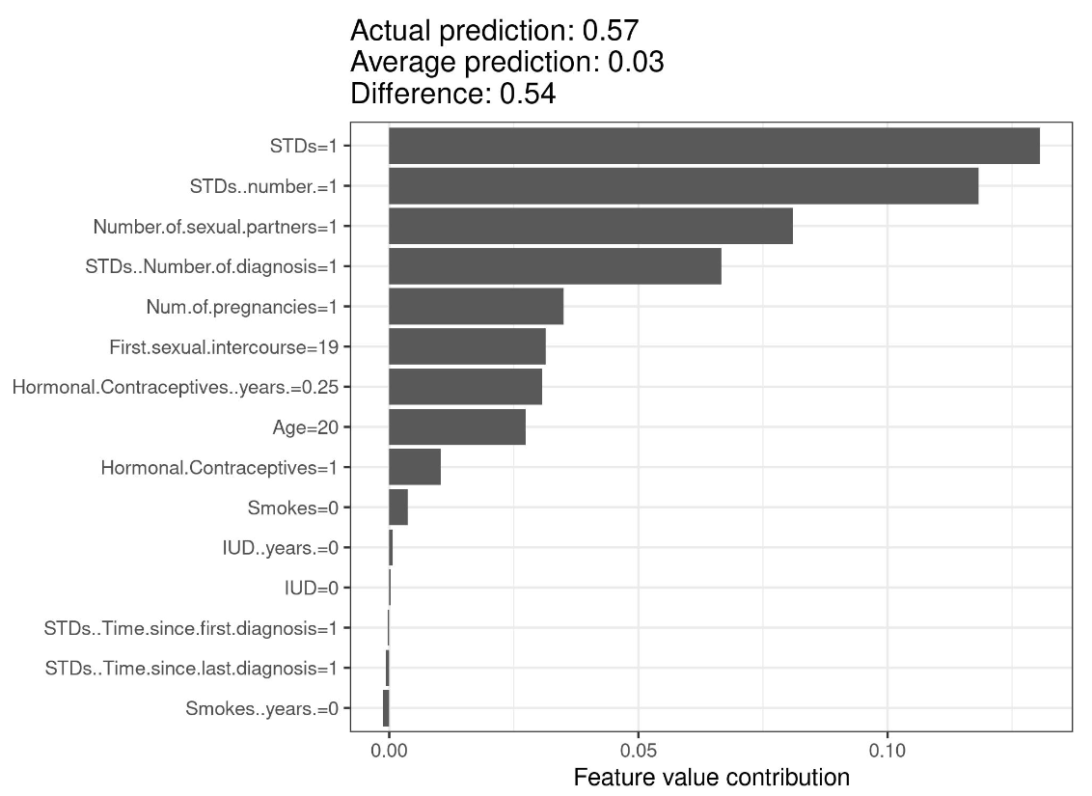
Shapley Values https://papers.nips.cc/paper/2017/file/8a20a8621978632d76c43dfd28b67767-Paper.pdf
Feature contribution metric originating from cooperative game theory.
Adapted and used for post-hoc ML explainability purposes.
Shapley Values are the average marginal contribution of each feature to the difference between the given prediction and the average prediction.
Average prediction is computed on a reference group.
Notes:
Reference group is usually the whole dataset

Slide 14
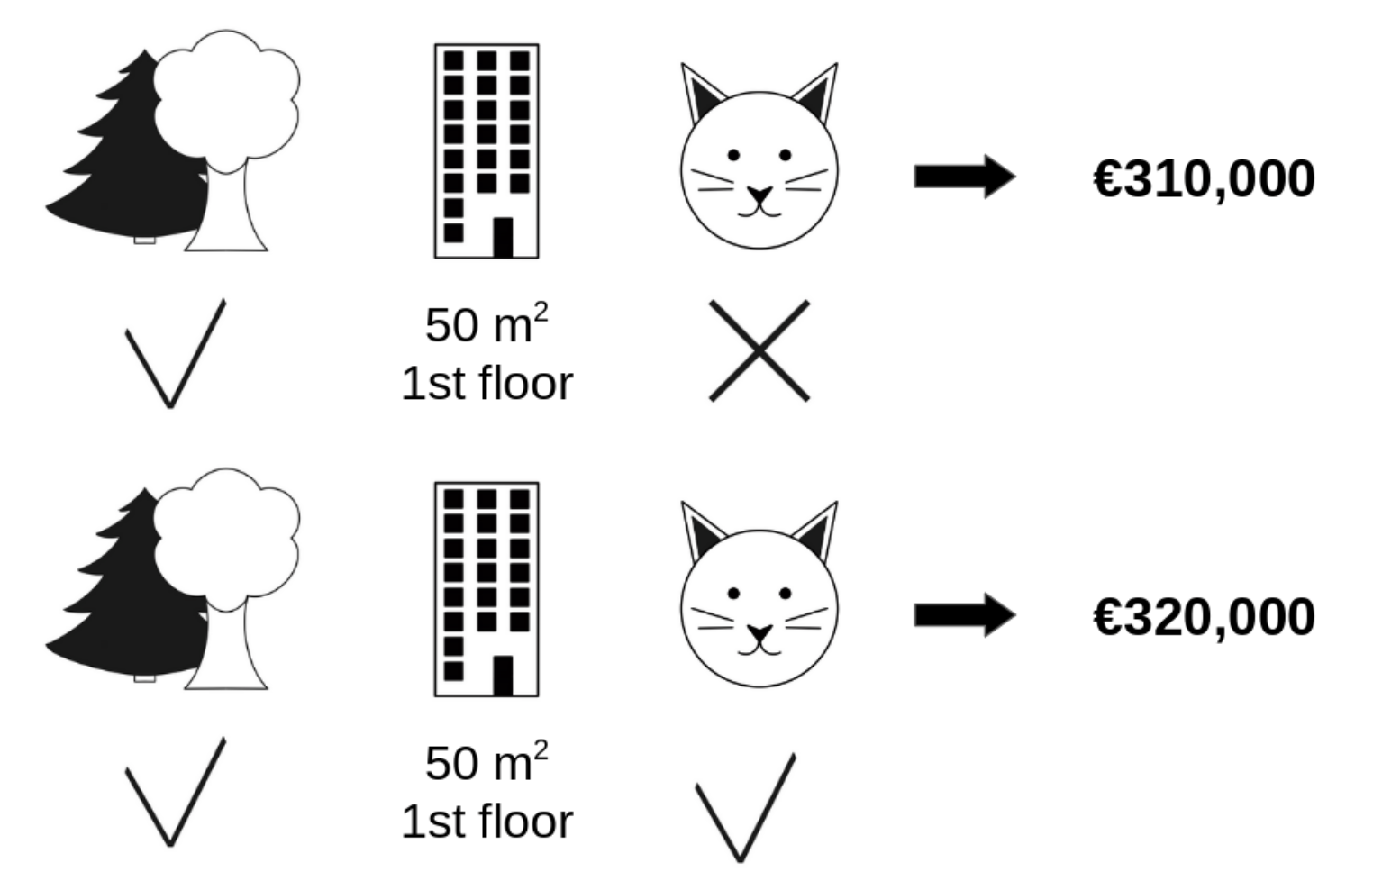
Shapley Values https://papers.nips.cc/paper/2017/file/8a20a8621978632d76c43dfd28b67767-Paper.pdf
Intuition: It’s unfair to say contribution of feature to prediction is (marginal) effect of when we change its value keeping all other feature values fixed. Because the effect is also due to interactions with the other variables. Thus, one has to calculate this marginal effect for all subsets of fixed values to consider all possible interactions of features and then (weightedly) average over these subsets.
The Interpretable ML Book gives as good explanation on how to calculate the Shapley Values.

Slide 15
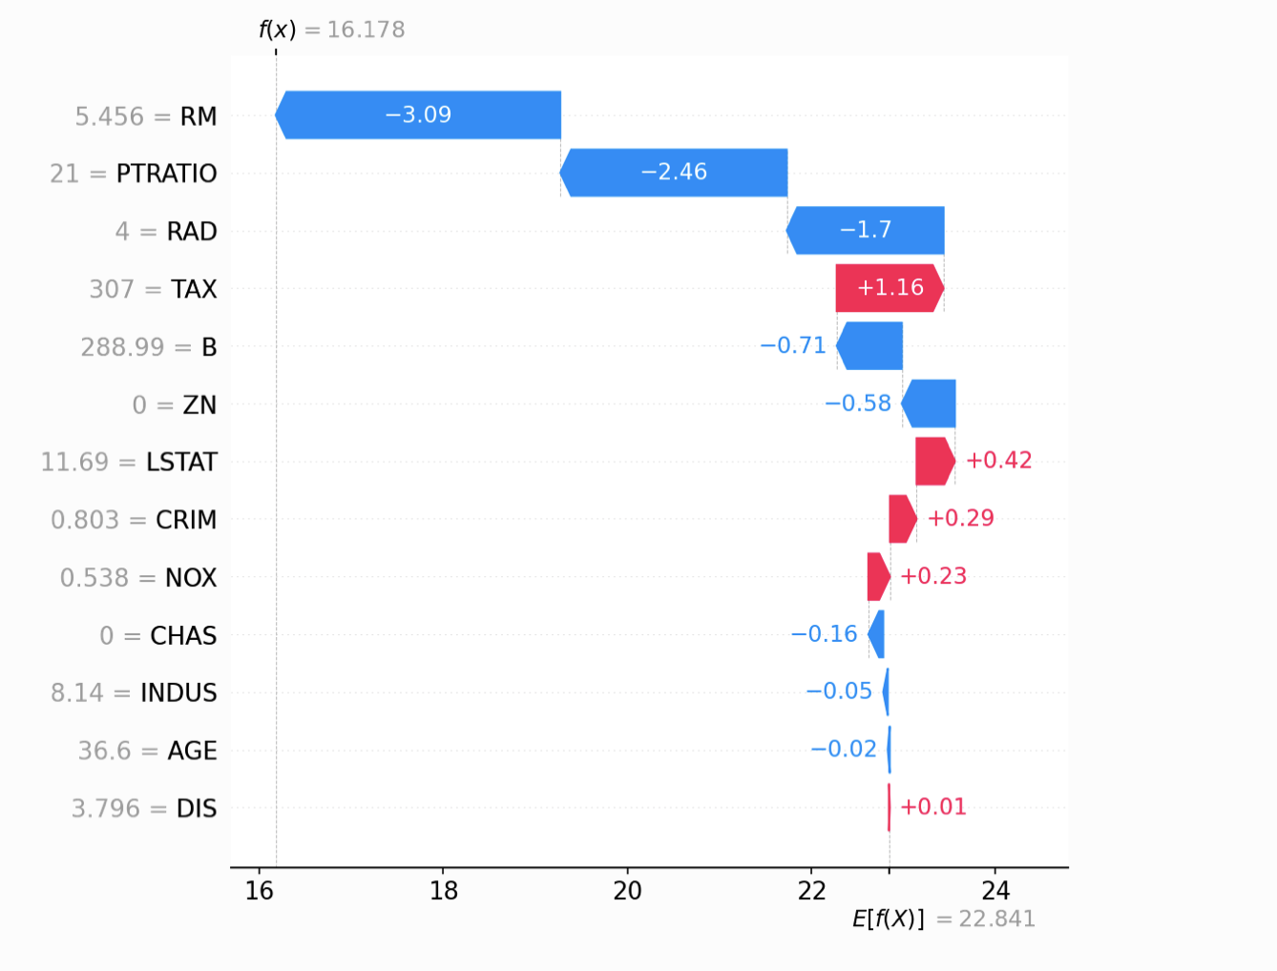
Shapley Values https://papers.nips.cc/paper/2017/file/8a20a8621978632d76c43dfd28b67767-Paper.pdf
Axiomatic metric:
Efficiency: sum of values across input features add up to the difference between given and average prediction.
Global feature importance by averaging absolute Shapley Values over dataset for each feature.
Pros:
Model agnostic approach, only requires input-output pairs.
Information about local predictions as well as the global model.
Cons:
Computation time increases exponentially with number of features.
Requires approximations in most real-world datasets.
Understanding of Shapley Values is not straightforward.
Notes:
Interpretation(!=Interpretability) of Shapley Value is average “marginal” contribution which is not the same as what happens if I remove feature or what happens if I change feature value. The interpretation of the Shapley value is: Given the current set of feature values, the contribution of a feature value to the difference between the actual prediction and the mean prediction is the estimated Shapley value

Slide 16
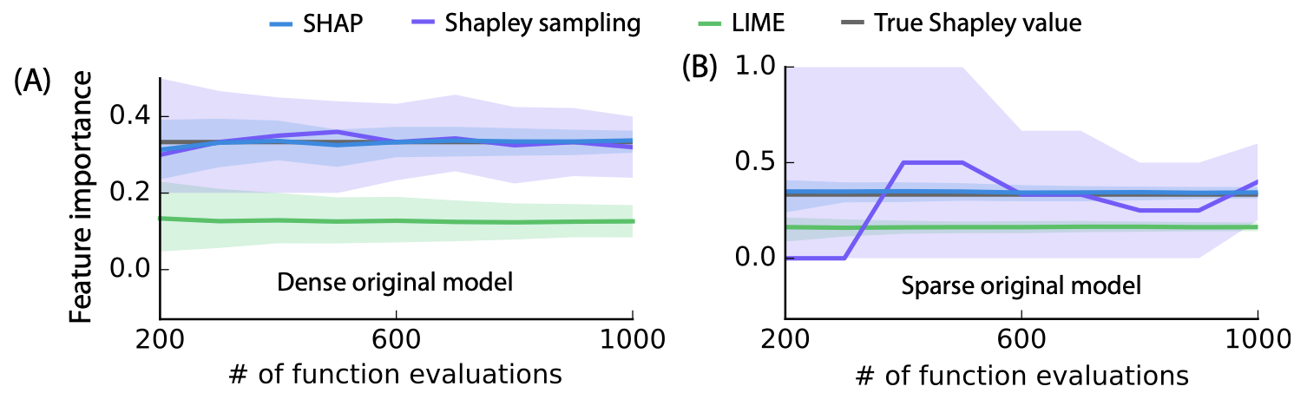
SHapley Additive exPlanations (SHAP)
SHapley Additive exPlanations (SHAP) combines sampling with other explainable approaches (i.e. Local Surrogate Models - LIME, DeepLift):
Increased computational efficiency.
Improved approximation of true Shapley Values.
Various approximation methods :
Kernel SHAP: model-agnostic
Linear SHAP: independence assumption
Deep SHAP: deep networks
Notes:
Shapley sampling values uses sampling methods to approximate true Shapley values
SHAP on the other hand combines with LIME / other local models to better approximate Shapley Value. Eg KernelSHAP = Lime +Specific kernel
Figure 3: Comparison of three additive feature attribution methods: Kernel SHAP (using a debiased lasso), Shapley sampling values, and LIME (using the open source implementation). Feature importance estimates are shown for one feature in two models as the number of evaluations of the original model function increases. The 10th and 90th percentiles are shown for 200 replicate estimates at each sample size. (A) A decision tree model using all 10 input features is explained for a single input. (B) A decision tree using only 3 of 100 input features is explained for a single input.

Slide 17
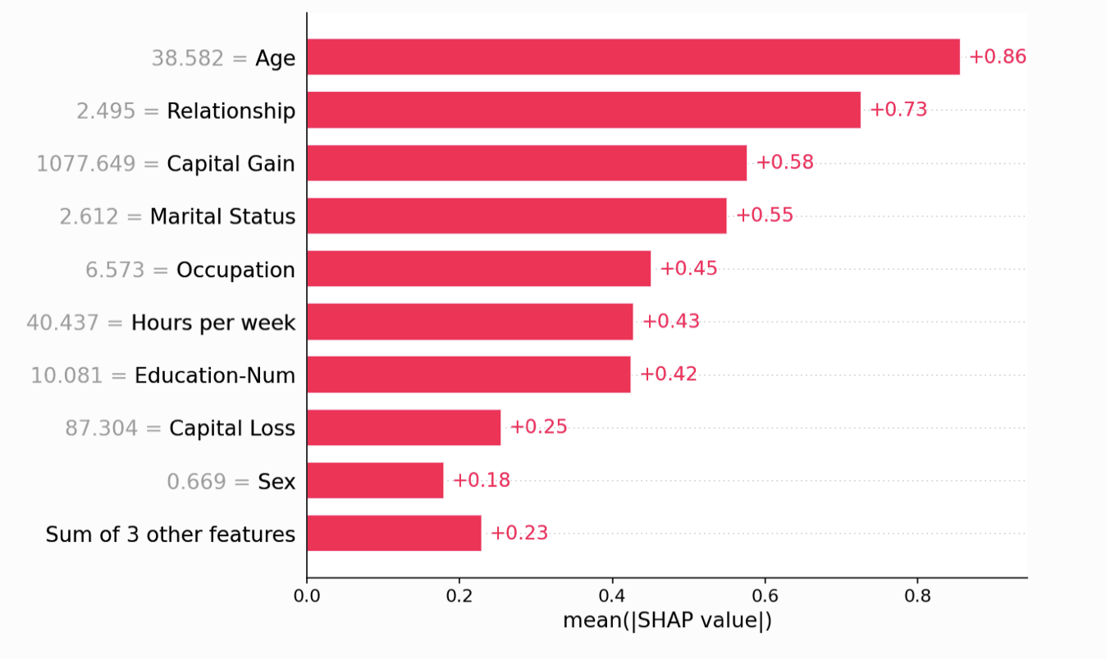
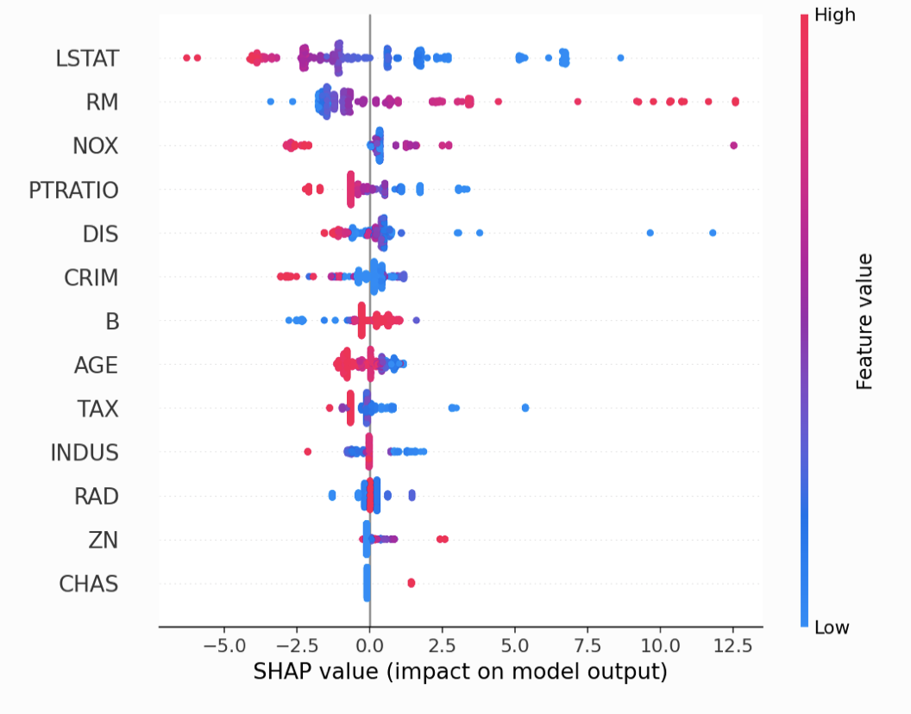
SHAP Python library https://shap.readthedocs.io/en/
Provides automatic estimates of Shapley values for wide range of ML/DL models types. (1)
Provides visualisations of Shapley values for explainability purposes. (2 )
https://shap.readthedocs.io/en/latest/api.html#explainers
https://shap.readthedocs.io/en/latest/api.html#plots
Notes:
other post-hoc interpretability metrics : LIME
post-hoc interpretability measurement
SHAP value is computed based on the impact (positive/negative) of each input variable on each output variable
all combinations of input variables are tested to assess the impact of each variable
open-source library for SHAP computation + cool visualisations for images and more

Slide 18
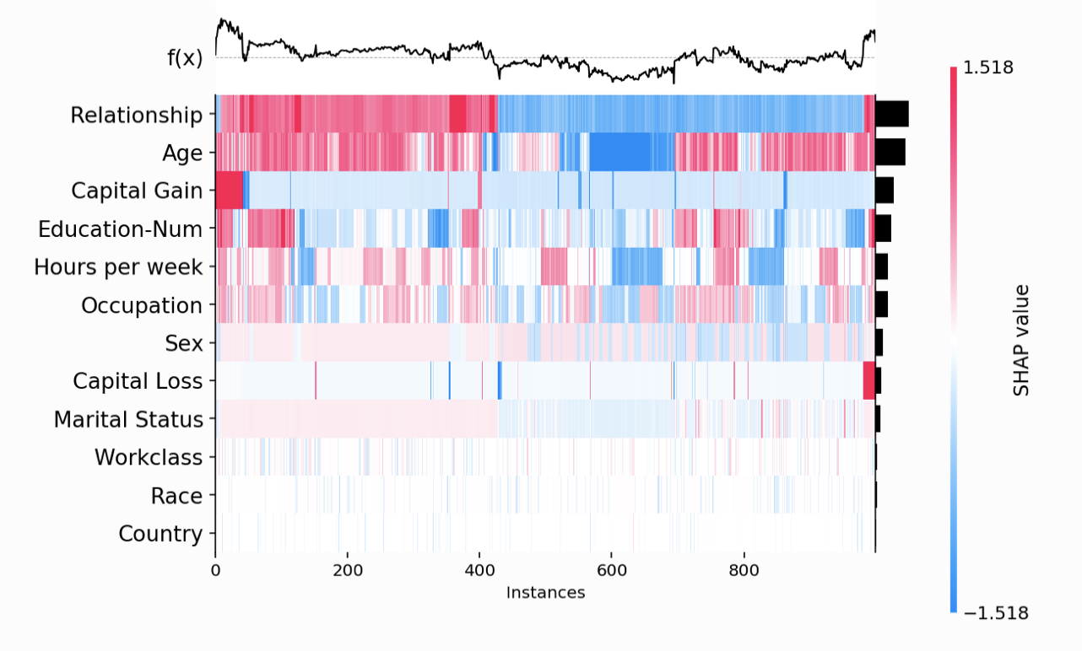
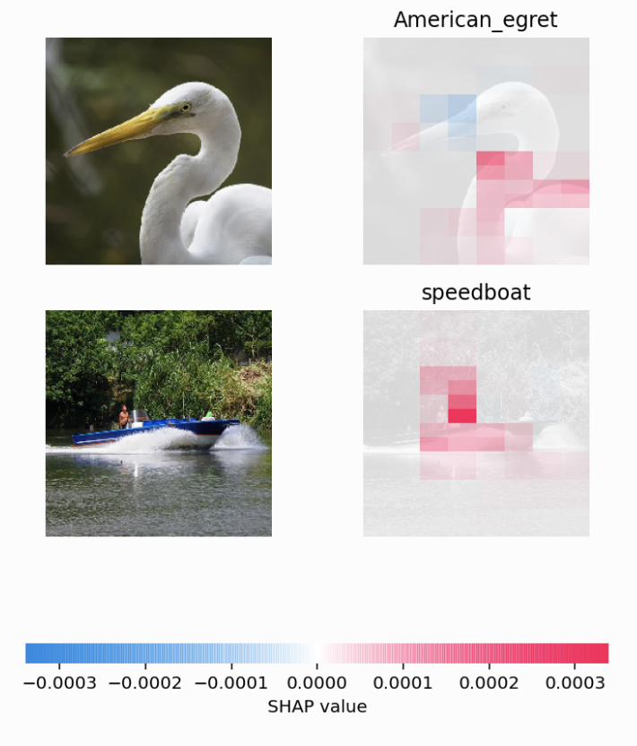
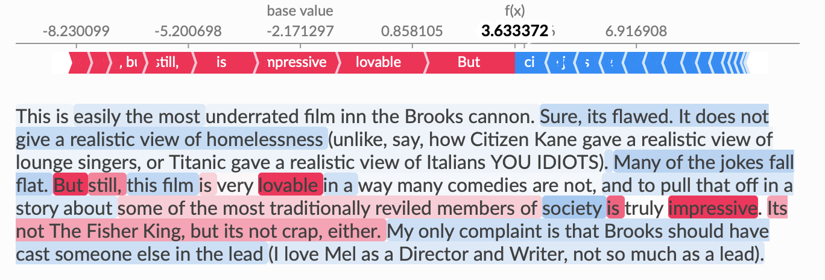
SHAP Python library https://shap.readthedocs.io/en/
Provides automatic estimates of Shapley values for wide range of ML/DL models types. (1)
Provides visualisations of Shapley values for explainability purposes. (2 )
https://shap.readthedocs.io/en/latest/api.html#explainers
https://shap.readthedocs.io/en/latest/api.html#plots
Notes:
other post-hoc interpretability metrics : LIME
post-hoc interpretability measurement
SHAP value is computed based on the impact (positive/negative) of each input variable on each output variable
all combinations of input variables are tested to assess the impact of each variable
open-source library for SHAP computation + cool visualisations for images and more

Slide 19
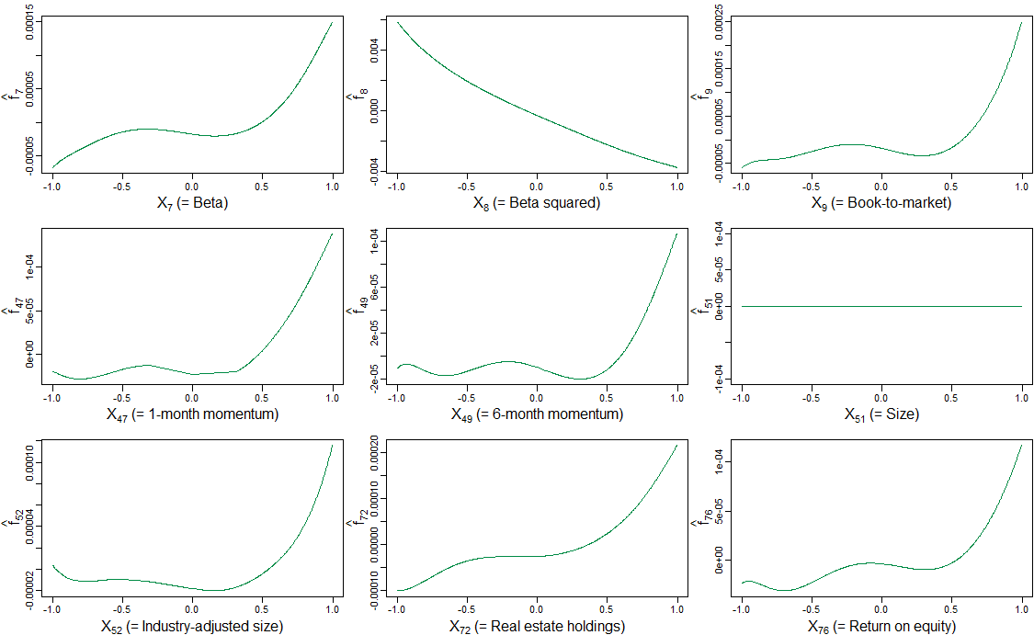
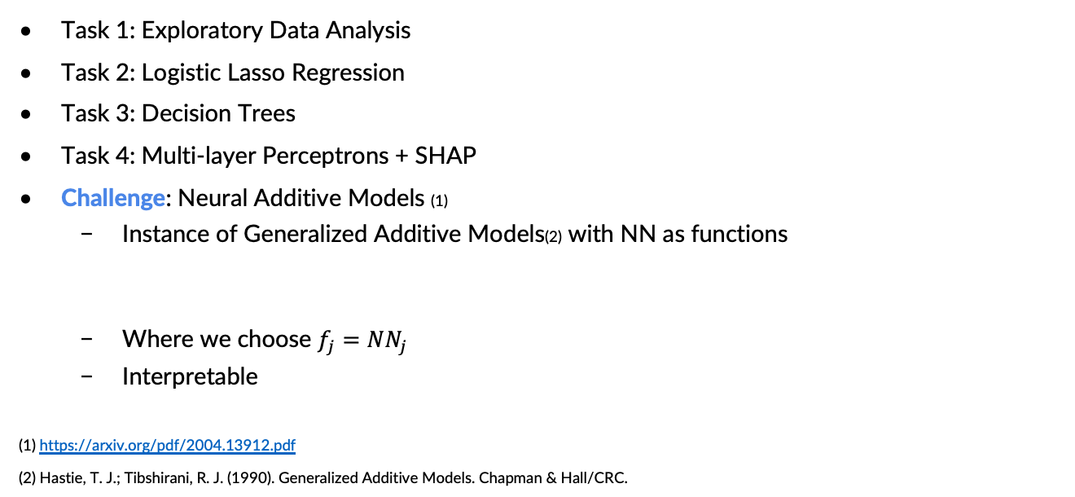
Tasks for Part 1 (detailed description of deliverables in handout)
Task 1: Exploratory Data Analysis
Task 2: Logistic Lasso Regression
Task 3: Decision Trees
Task 4: Multi-layer Perceptrons + SHAP
Challenge: Neural Additive Models (1)
Instance of Generalized Additive Models(2) with NN as functions
Where we choose $f_{j}=NN_{j}$
Interpretable
(1) https://arxiv.org/pdf/2004.13912.pdf
(2) Hastie, T. J.; Tibshirani, R. J. (1990). Generalized Additive Models. Chapman & Hall/CRC.

Slide 20
Motivation for predicting pneumonia
For US adults, pneumonia is the most common cause of hospital admissions other than women giving birth (in 2011). (1)
Pneumonia is the worldwide leading cause of death for children under 5 (in 2017). (2)
Number of radiologists is growing slower than number of images they need to analyse. (3)
In this project, you will train ML models to detect pneumonia from X-rays.
With the help of interpretability and explainability, you will gain insights in whether your model uses the medically revelant parts of the image for its prediction or if it uses some biases / shortcuts.
These insights builds trust in radiologists towards a (semi-)automated detection of pneumonia.
https://academic.oup.com/ehjopen/article/1/1/oeab001/6294753
https://ourworldindata.org/pneumonia
(3) https://www.diagnosticimaging.com/view/are-we-prepared-for-a-looming-radiologist-shortage-

Slide 21


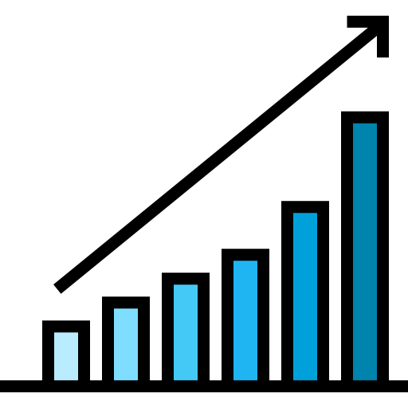


Medical Imaging Techniques
Medical Imaging Techniques are at the heart of our medical systems:
Magnetic Resonance Imaging (MRI), Computed Tomography (CT), Echographies , X-rays, …
1.18M CT exams & 1.06M MRI exams per year in Switzerland in 2019(1)
Prevalence is increasing in Switzerland (+25% of scanners in CH over the past 5 years)(1)
… increased workload for practitioners
Interest from investment funds into Medical Imaging AI Companies (estimated 600M$ in 2020)(2)
(1) https://www.bfs.admin.ch/bfs/en/home/statistics/catalogues-databases/press-releases.assetdetail.16584130.html
(2) https://www.signifyresearch.net/medical-imaging/vc-funding-for-medical-imaging-ai-companies-tops-2-6-billion
Notes:
covid pandemic

Slide 22
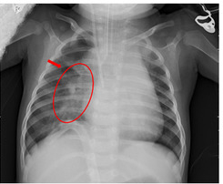
Clinical Background
Pneumonia is an infection that inflames the air sacs (alveoli) in one or both lungs.
Typical symptoms: Chest pain when breathing, cough, fever, shortness of breath.
To diagnose pneumonia, the infected tissue will show denser areas and therefore appear as white spots in the darker background of the lungs.
https://healthmatch.io/pneumonia/pneumonia-chest-xray
https://www.lung.org/lung-health-diseases/lung-disease-lookup/pneumonia/symptoms-and-diagnosis
https://www.mdpi.com/2227-7390/8/9/1423

Slide 23
Chest X-Ray Dataset (1,2)
Dataset of 1-5 year old children from Guangzhou Women and Children’s Medical Center.
5,863 X-ray images (JPEG) annotated with pneumonia/no pneumonia.
Train - val - test split provided directly on kaggle. Feel free to rearrange train/val but please keep the testset as-is for comparability and reproducibility.
Overall goal: Develop an automated ML model for the detection of pneumonia and leverage interpretability or explainability to investigate whether it uses the medically relevant features for its prediction.
Kermany, Daniel S., et al. "Identifying medical diagnoses and treatable diseases by image-based deep learning." cell 172.5 (2018): 1122-1131.
https://www.kaggle.com/datasets/paultimothymooney/chest-xray-pneumonia
Notes:
Chest X-ray images (anterior-posterior) were selected from retrospective cohorts of pediatric patients of one to five years old

Slide 24
Tasks for Part 2 (detailed description of deliverables in handout)
Task 1: Exploratory Data Analysis
Before training any classifier, analyze the dataset at hand in order to get an understanding of the data.
Do you see visual differences between healthy and disease patients?
Based on your findings, preprocess the data as you see fit.

Slide 25
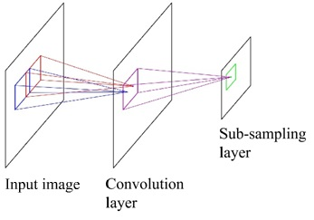
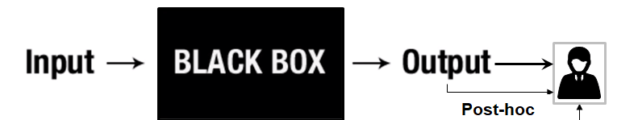
Tasks for Part 2 (detailed description of deliverables in handout)
Task 1: Exploratory Data Analysis
Task 2: CNN Classifier
For Task 3 & 4, we want use post-hoc explainability methods, which visualize the parts of the image a classifier utilizes for its predictions.
Thus, first design a small CNN classifier on which we can lateron apply these methods.

Slide 26
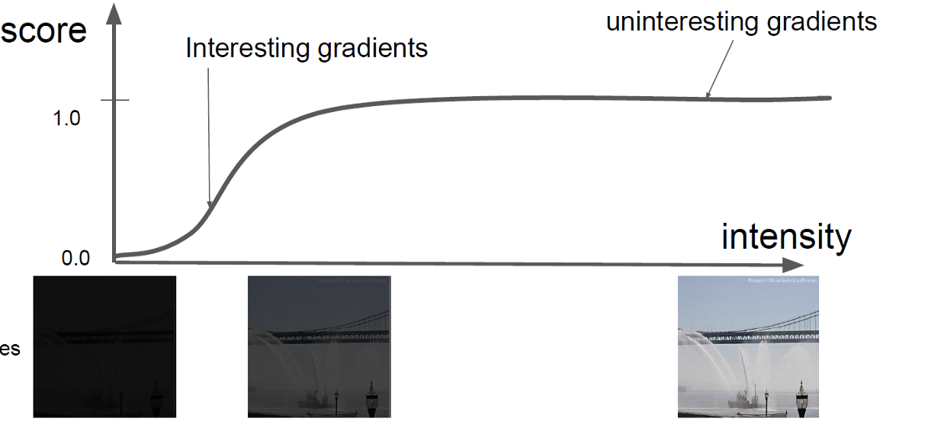
Tasks for Part 2 (detailed description of deliverables in handout)
Task 1: Exploratory Data Analysis
Task 2: CNN Classifier
Task 3: Integrated Gradients (1)
Gradient-based post-hoc methods take inspiration from the idea that the gradient of the prediction loss with respect to the input pixels indicates how important they are.
Gradients at image might not accurately describe importance of pixels for prediction.
Integrated Gradients sums up gradients over the path from a baseline (usually black image) to the image.
(1) Sundararajan, Taly, and Yan, “Axiomatic Attribution for Deep Networks.”

Slide 27
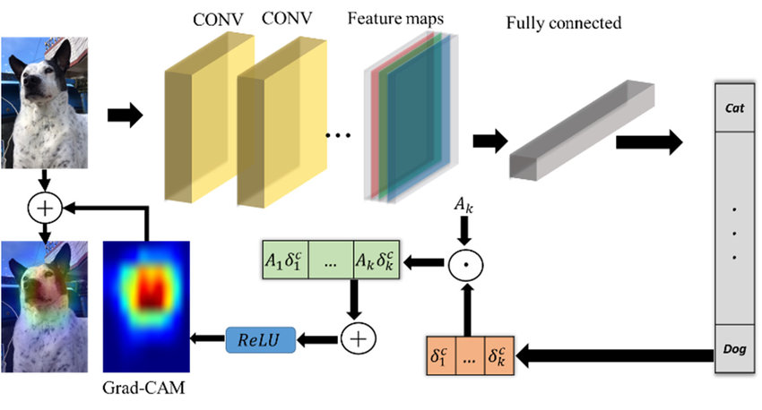
Tasks for Part 2 (detailed description of deliverables in handout)
Task 1: Exploratory Data Analysis
Task 2: CNN Classifier
Task 3: Integrated Gradients
Task 4: Grad-CAM (1)
Grad-CAM uses activation maps of last convolutional layer from forward pass, weighs them by gradients and upsamples them to input image.
(1) Selvaraju et al., “Grad-cam: Visual explanations from deep networks via gradient-based localization”
Notes:
Con: Coarse

Slide 28
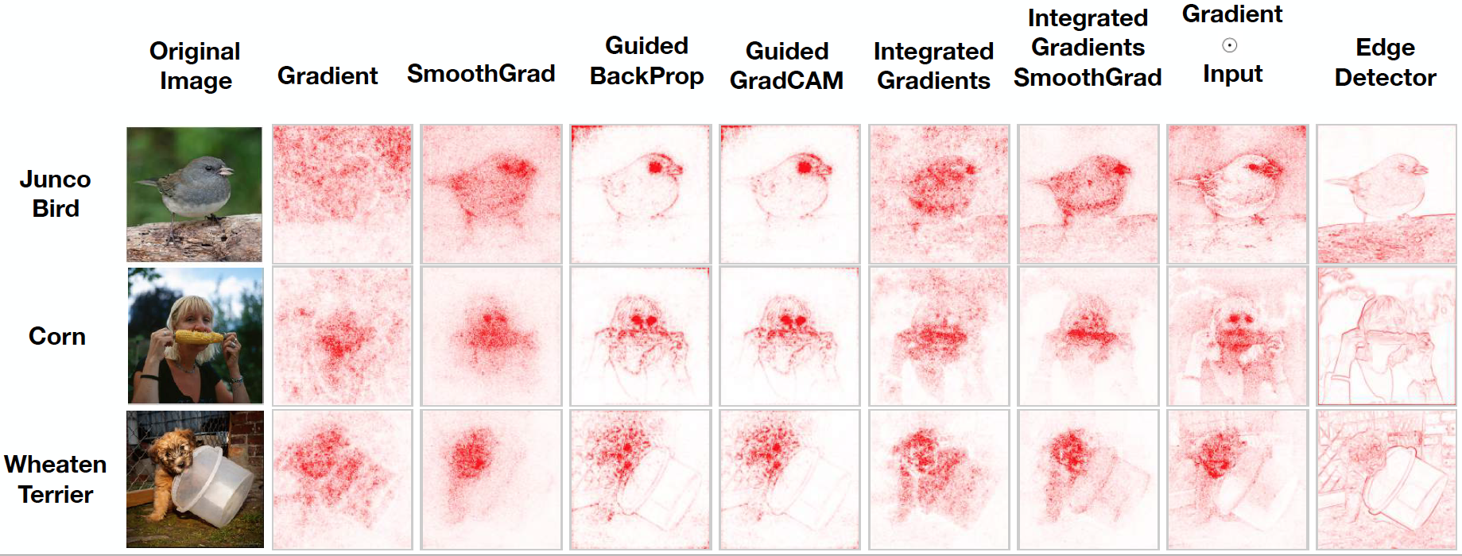
Tasks for Part 2 (detailed description of deliverables in handout)
Task 1: Exploratory Data Analysis
Task 2: CNN Classifier
Task 3: Integrated Gradients
Task 4: Grad-CAM
Task 5: Data Randomization Test (1)
Show that many gradient-based post-hoc explainability methods work as edge detectors.
When randomly permuting labels of images, the resulting “important pixels” for classification should be random and non-sensical.
Instead, many methods still visualize similar important pixels as before randomization.
Effectively showing that methods are independent of model and classification task at hand and, thus, a bad explainer of the model.
A premise of interpretable models is that this would not happen for them
(1) Adebayo et al., “Sanity Checks for Saliency Maps.”

Slide 29
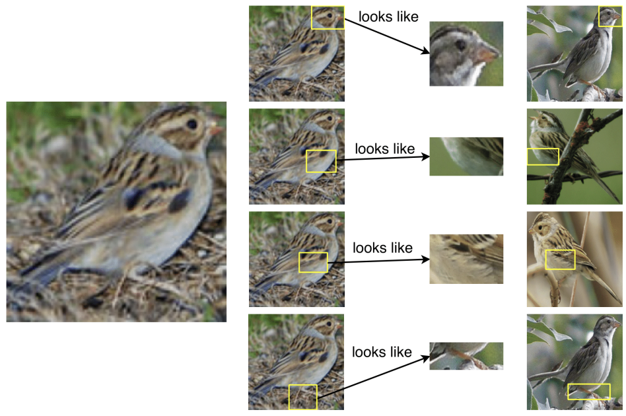
Tasks for Part 2 (detailed description of deliverables in handout)
Task 1: Exploratory Data Analysis
Task 2: CNN Classifier
Task 3: Integrated Gradients
Task 4: Grad-CAM
Task 5: Data Randomization Test
Challenge: Prototype Learning (1)
Prototypes can be either determined beforehand (1) or jointly with classifier. (2)
Given a set of prototypes, one can use the k-nearest neighbor algorithm for prediction.
In this project we will focus on the simple case of first learning prototypes using maximum mean discrepancy and then predicting the label given these prototypes.
Interpretable
(1) Kim, Khanna, and Koyejo, “Examples Are Not Enough, Learn to Criticize! Criticism for Interpretability.”
(2) Chen et al., “This Look Like That: Deep Learning for Interpretable Image Recognition.”
Notes:
Image is a clay colored sparrow

Slide 30
Part 3
General questions allowing you to reflect on your learnings during the project

Slide 31

Supplementary Material
https://christophm.github.io/interpretable-ml-book/

